Slide 1
Connecting Message to Money
Angelo M. Valente
Executive Director
Partnership for a Drug-Free New Jersey
December 9, 2014

Slide 2
Today’s Session
Money makes the “non-profit” world go round. A successful non-profit leader must be cognizant that they are not only responsible for the overall management of their organization, but, also the funding sources that keep the organization functioning. Success breeds success. It is crucial for funders to understand and be knowledgeable of the organization and its mission, if they are expected to be fully committed.

Slide 3
Objectives
Participants will identify the distinguishing factors between successful fundraising efforts and mediocre campaigns. Most importantly, participants, will acquire the skills to self-promote in preparation for a successful development campaign.

Slide 4
Introductions
Who do we represent today?

Slide 5
Introduction of Angelo Valente
Angelo M. Valente has been the Executive Director of the Partnership for a Drug-Free New Jersey, since its inception in 1992, and has led this organization in becoming the largest continuous Public Service Campaign in New Jersey’s history.
Mr. Valente has recently been appointed as the Chief Executive Officer of the American Medicine Chest Challenge (AMCC), a national public health initiative to raise awareness of the issue of prescription drug abuse and maintain a National Directory of Permanent Prescription Drug Collection sites. AMCC services over 1,000 community and law enforcement partners in all 50 states, the District of Columbia, and three Indian Nations.
Mr. Valente and the Partnership have been recognized by the White House Office of National Drug-Control Policy, the Community Anti-Drug Coalition of America, the Partnership for a Drug-Free America, and the National Association of Government Communicators for their creative and innovative substance abuse prevention campaigns and initiatives.
He serves as a member of the Holy See’s Delegation to the United Nations, focusing on international drug control strategy.
Angelo holds a Bachelor’s Degree from Montclair State University. He also holds Master Degrees from Fairleigh Dickinson University in Public Administration and from Seton Hall University in Diplomacy and International Relations.
Mr. Valente and his wife, Jane have three daughters, Hannah, Mia, and Marietta.

Slide 6

Founding of the PDFNJ
… It all started with an egg…

Slide 7

Determining a Board
What is your value?
What do you need?
What will make you successful?
    PDFNJ Example: Who can help promote the PDFNJ PSAs

Slide 8
Leveraging the Board
Using the influence of your Board
Sponsorship of specific programs vs. general fundraising
Host meetings at locations of your board members
Giving your Board Ownership:
PDFNJ Examples:

Slide 9

PSE&G Third Grade Contract for a Healthy Life

Slide 10

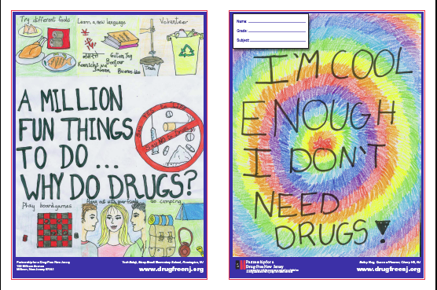
Verizon Design a Fourth Grade Folder Contest

Slide 11

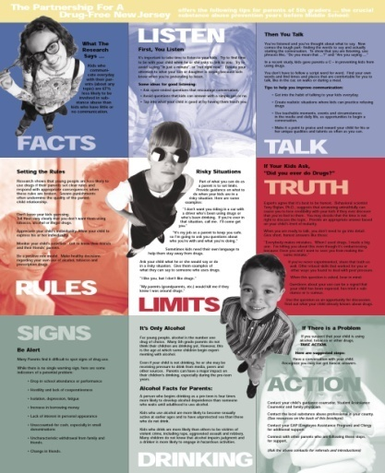


Horizon Foundation Of New Jersey 5th Grade Parent Alert
Focus on Prescription Drug Abuse Prevention Information
The 5th Grade Parent Alert program is supported by the Horizon Foundation for New Jersey, which promotes health, well-being, and quality of life in New Jersey’s communities. Priority areas include health, the arts, and education.

Slide 12

Annual Middle School PSA Challenge
WWOR

Slide 13


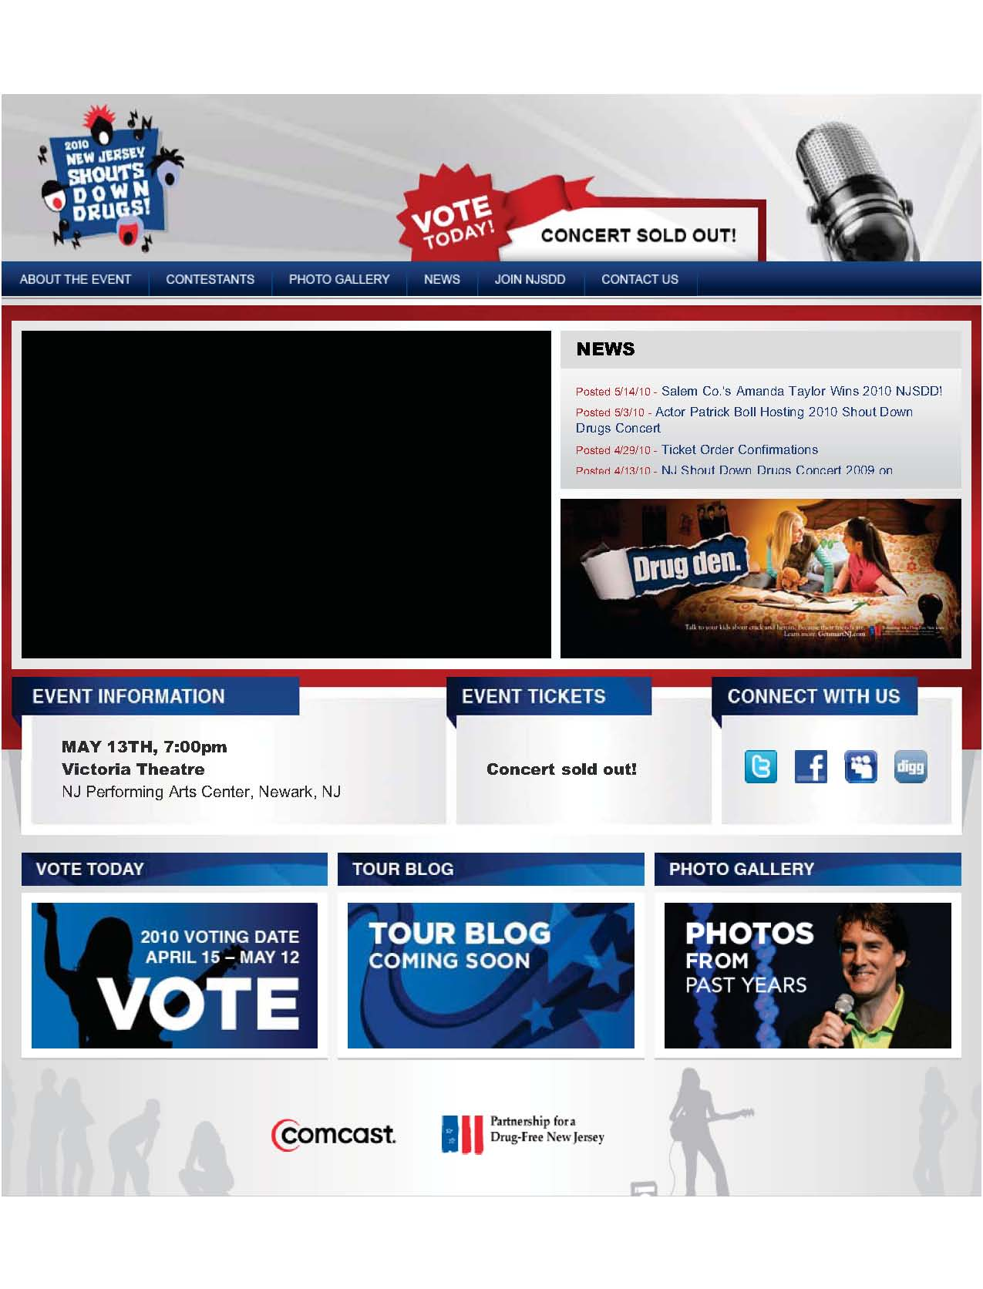

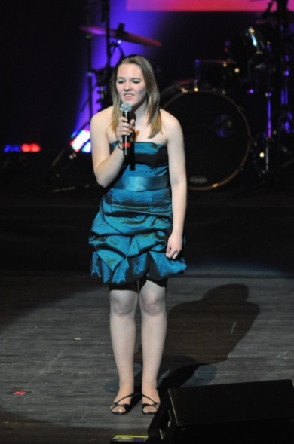
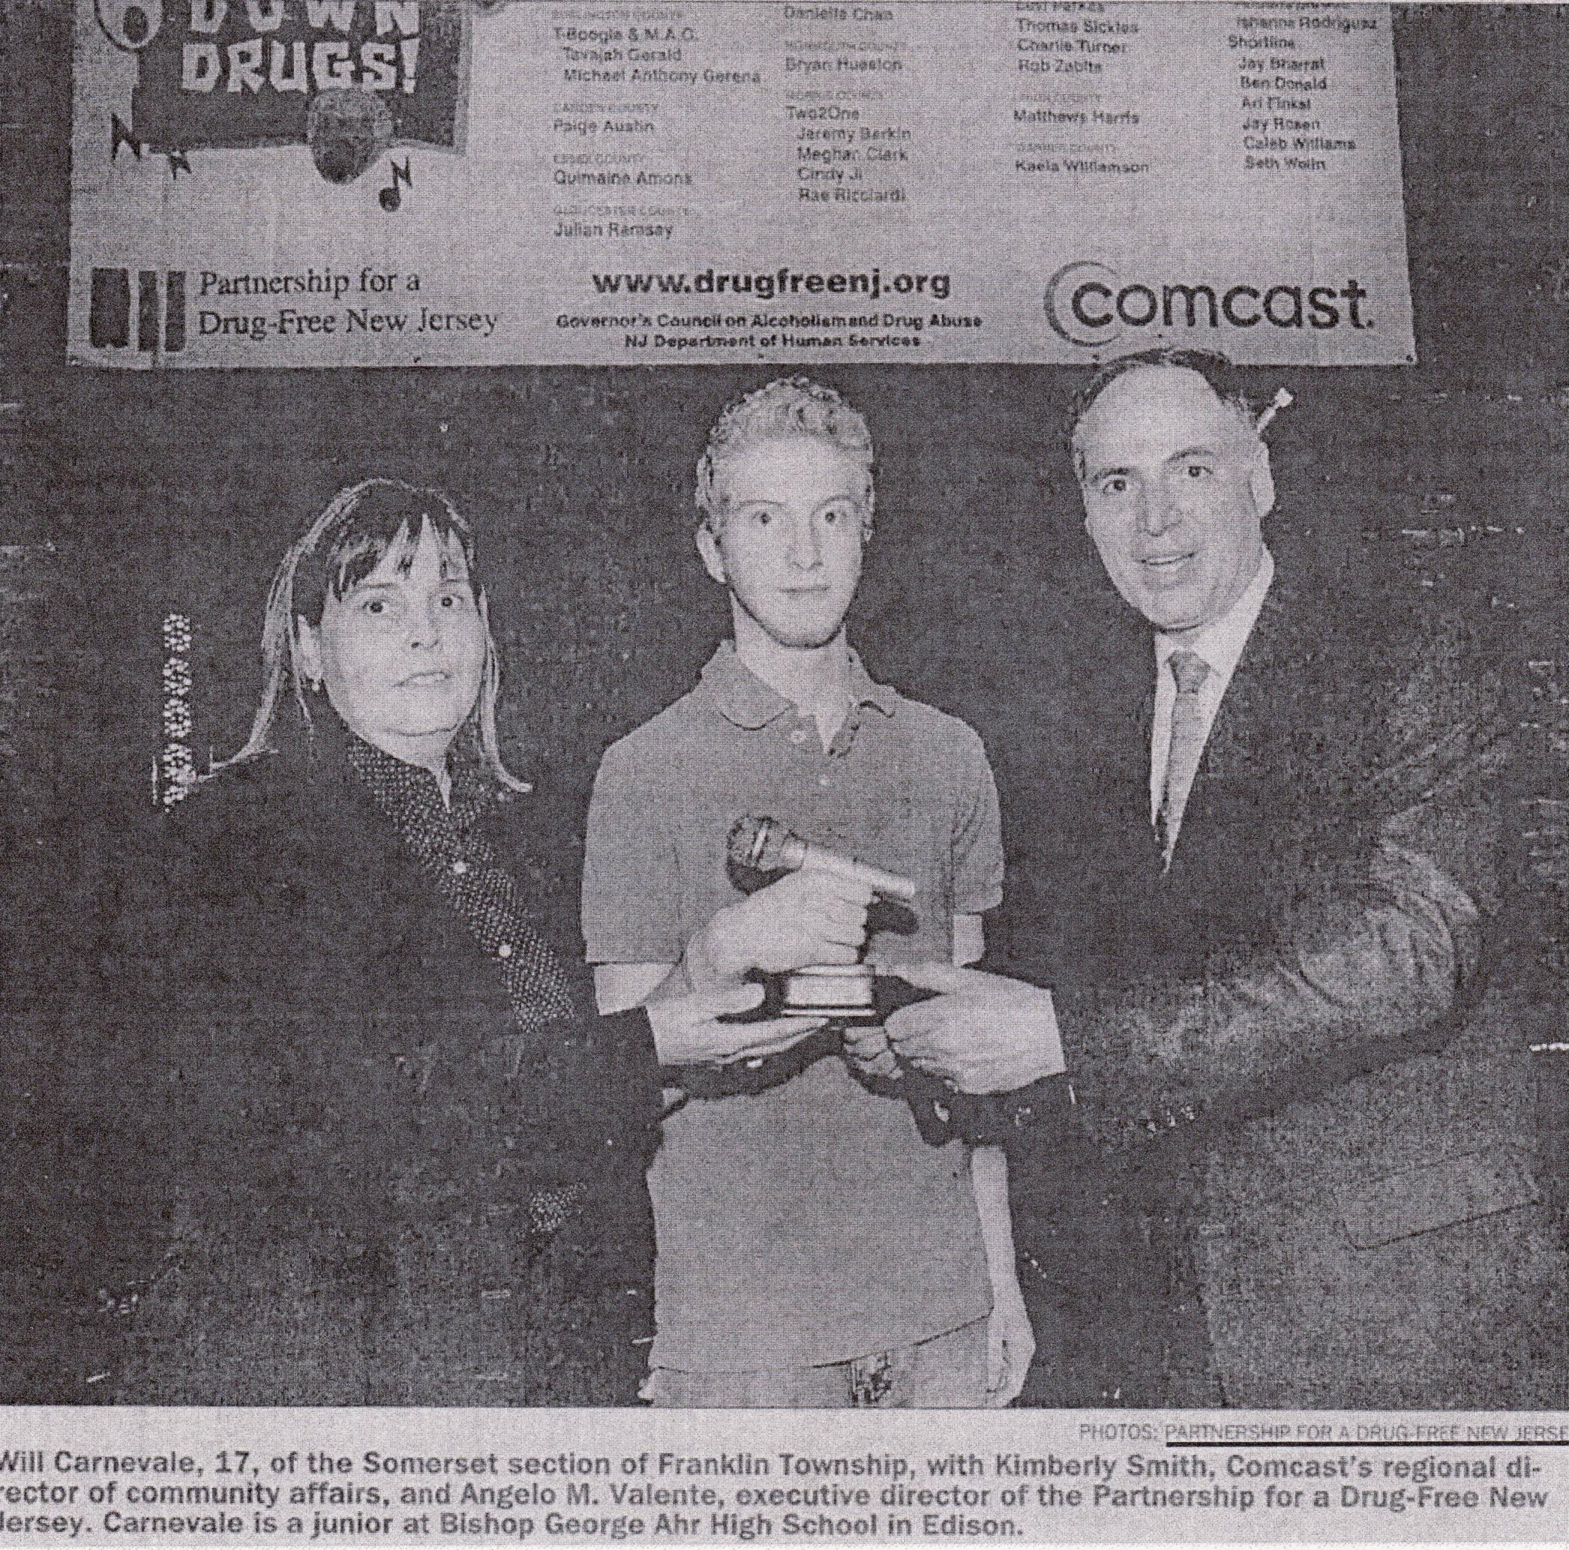
New Jersey Shouts Down Drugs
http://shoutdowndrugs.com/

Slide 14
Fundraising
Identify the distinguishing factors between successful fundraising efforts and mediocre campaigns;
  Don’t Be Cheap – invest in your investors
  Networking
  Strength in Numbers
  Set realistic goals

Slide 15
Cause Related Marketing
What are the advantages of cause-related marketing?
There are advantages for both nonprofit and business. For business, cause-related marketing proves that it is socially responsible and provides great public awareness of its values and willingness to support good causes.
For the nonprofit, the contributions from a cause-related marketing project can be significant, and those funds are usually unrestricted so even overhead costs can be supported by them. Besides actual monetary benefit is the intangible value of the publicity and advertising that usually accompanies a cause-related marketing program, which is often done by the corporation's public relations and marketing departments in tandem with the nonprofit's own marketing.

Slide 16
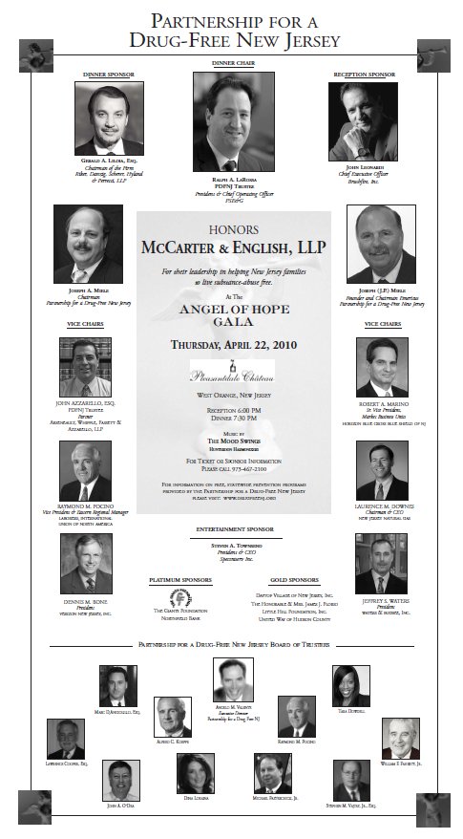
Recognize your funders

Slide 17
Recognize Your Funders
  Personalize approaches to development based on the funders own goals and objective
www.TalkNowNJ.Com
https://www.youtube.com/watch?v=rDmcxxhpysI

Slide 18
Skills needed to self-promote for a successful development campaign
  Maximize minimum resources
  Personalize approaches to development based on the funders own goals and objective
  The more successful you are the more they will contribute to you

Slide 19
What are your goals, objectives and challenges

